Slide 1
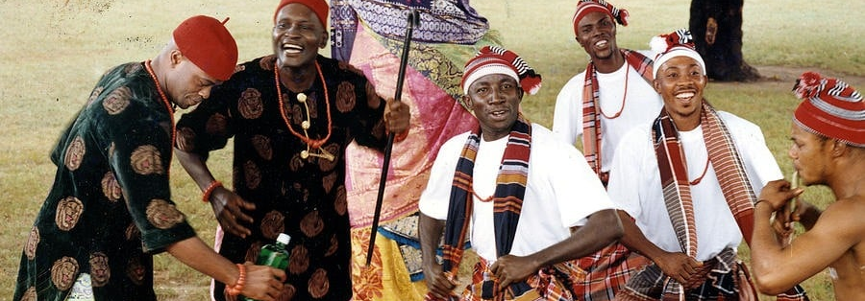
Constitution of the Mid-Mo Igbo Union in Columbia- United States

Slide 2
PREAMBLE:
We the members of Mid-Mo Igbo Union Columbia
Having firmly and solemnly resolve, to exist in unity and harmony as one indivisible and reputable organization under Igbo Union Columbia, dedicated to the promotion of Igbo solidarity, Member co-operation and appreciation and promotion of Igbo cultural values.
And to provide for a Constitution for the purpose of promoting the good government and welfare of all members in our union, on the principles of freedom, equality and justice, and for the purpose of consolidating the unity of our Union in United States
Do hereby make, enact and give to ourselves the following Constitution:

Slide 3
Article 1. Name and Domicile of the Association
The name of the Association shall be called Mid-Mo IGBO UNION in Columbia (aka – Nzuko ndi Igbo). The Association is domiciled in Columbia, United States.

Slide 4
Article 1.1 Status of the Union.
The Igbo Union has the status of legal person and is subject to the jurisdiction and protection of the laws of United States.
All of it’s activities shall be governed by the American/Missouri laws in accordance with the laws and regulations concerning the registration of an association.

Slide 5
Article 1.2. Language:
The meeting shall have Igbo as its language of deliberation, though English language can be used sparingly and for its minutes.(* A Suggestion)

Slide 6
Article 2. Aims and Objectives:
a) The aim of the Association is to facilitate contacts and to promote cultural interaction and understanding among members.
b) The objective of the Association is to work for the peace and progress of Igbos and their families in Missouri. This is to be accomplished through:
i) Promoting the spirit of togetherness and brotherhood among Igbos and their families through social/cultural interactions.
ii) Serving as the umbrella organization under which Igbo men, women and children may come together in achieving the common goal of understanding and self help.
iii) Keeping alive Igbo traditions and customs as celebrated in our rich festivals and cultural institutions.
iv) Encouraging and when possible assisting Igbos in legitimate business or in promoting cultural activities.( *suggestion)

Slide 7
v) Promoting the teaching of Igbo language and culture to our children and to other interested people (e.g. Missourians).
vi) Fostering cultural understanding between Igbo, and people from other nationalities through the promotion of cultural exchange.
vii) Joining with American Igbo organizations in the promotion of Igbo cause(in the future)
In order to meet these aims and objectives, the Union shall organize cultural happenings, meetings, lectures, discussions, information exchange and excursions. It shall also give useful and practical advice or information to Missourians and Igbos in their interactions. The Union shall be an Independent, non-political, non-profit seeking organization.
In seeking to support its activities, the Union may receive donations and legacies on different types of social occasions (happenings).

Slide 8
Article 3. Memberships:
The membership of the Igbo Union shall be open to all Igbo indigenes and non-indigenes resident in Columbia or its environs

Slide 9
Article 3.1 Registration:
Intending member must duly fill in the required membership form to express his/her willingness to joining the Union. A member is required to pay his/her registration fee as well as other dues like
monthly/annual dues or any other dues approved by the general assembly.

Slide 10
Article 3.2 Membership Dues:
Registration and yearly membership fee shall be decided during the Union’s annual meeting. Registration fee is paid once, while Annual due varies from year to year as may be accepted by the majority during the general Assembly.
Annual dues can be paid either in whole or installment basis as may be desired by such member, but shall be completed by mid year of the accounting period. If for some reason(s) where a member can not meet up the dead line and supported with adequate explanation to the Executive Board, such member may be granted an extension not more than two months to complete such dues.

Slide 11
Other Dues:
Members of Ibo Union are obliged to honor other dues generally accepted by the house, which for some reason are deemed necessary for the execution of unforeseen duties which may arise from time to time. Donations are also welcomed for the support of project, or related issues of interest.
Non-Financial member:
A member shall be considered to be inactive/non-financial member of the Union if he or she has not paid the membership fees or other dues within one year after the expiring date.

Slide 12
Meetings and Invitation to meetings:
The Union shall have at least twelve meetings in a calendar year, (i.e. every last Sunday of the month) unless otherwise directed by the Executive Board or Emergency meeting called or “unofficially” requested by any member of the Union due to ceremonial reasons, grief or other reasons due to unforeseen circumstances. Such meeting request shall be honored by the members of the Union.

Slide 13
Invitation:
The Union Secretary or any other person in charge shall send meeting circular to registered members either in writing (e.g. email), by text messages or phone calls two weeks before such general meeting. Agenda for meetings shall be attached when sending circular.
Any member of the Union with good article for discussion may send such topic to the Executive committee to be added in the agenda for deliberations during the meeting.
Emergency meetings or any other form of meetings requiring urgency can be communicated through SMS messages or email without long time notice as the case maybe.

Slide 14
End of the year Meeting:( *suggestion)
In the Union’s end of the year meeting, the following matters shall be handled:
1. Chairman’s opening of the meeting and end of the year report.
2. Financial Secretary end of the year report.
3. Auditors report to the general house
4. In case whereby there was an election of new board, such elected officers shall resume office immediately

Slide 15
Voting and Voting Right:
At the Union meeting, every financial member has the right to vie for position or vote. Each member is entitled to one vote.
Decision shall be made, if not ordered otherwise in this constitution, by the simple majority rule.
In case where votes are tied during the Union’s election, this shall be resolved by lot.

Slide 16
Executive Board:
The Union activities shall be directed by the Executive board which are elected after 4 years or following the relocation of one of the board.
A unanimous decision can be taken to appoint a member of the board if an election is deemed un-necessary
The Executive board shall be made up of:
i) The President
ii) Vice President
iii) Secretary
iv) Financial/Treasurer
v) Director of Socials

Slide 17
President:
The affairs of the Union shall be headed by the president . The Unions President shall posses the quality of good leadership. He or she will be able to take control and co-ordinate other members of the Executive as well as the general house. He or she shall be focused, organized, be able to run the affairs of the Union without fear or favor. He/She chairs the Executive board as well as the general Assembly. Though he reserves the right to appoint any member of the house to chair any gathering. The President will be deputized by the Vice President. The executive committee forms a quorum when the President or Vice-President and two other members are present.

Slide 18
Vice President:
In absence of the President, the Vice President shall call for an executive meeting or general meeting when he/she consider it necessary or when any other member of the executive demand so.

Slide 19
Secretary:
The union Secretary shall be responsible for the writing of minutes of all meetings whether on Executive or in a general Assembly level. He or she shall keep and maintain all official records concerning the Union. He or she shall be conversant with the rules and regulation at all time and read or interpret such rule when the need arises. The Secretary will summon meetings or gatherings of any such with directives coming from the Chairman or the Vice Chairman. In absence of both the Chairman and the Vice, the Secretary takes the podium to chair the meeting.
In absence of the Secretary, the Financial Secretary will act in taking the minutes of the meeting. The Secretary will be a committed member as he or she is the eye of the Union. The success of the union largely rests on the input of the Secretary.

Slide 20
Article
The Financial activities of the Union shall be recorded and saved by the Financial Secretary. He or she shall in addition be the treasurer for the Union. He or she shall be able to maintain a good record book, where all financial matters are entered for reference purposes when needed. He or she shall as well keep receipts of all purchases, record all dues received, payments made as well as fines collected, or any other monies received or levied for whatever purpose(s). He or she shall be accountable to the President on the financial position of the Union. He or she shall be able to present to the house at any meeting the financial statement of the Union.

Slide 21
Director of Socials:
He or she shall be in charge of all social activities of the Union. Whenever the union engages in any kind of social performance/activity, he or she shall head the committee for various duties assigned to them. Such events like; parties, refreshment during meetings, child birth of a member, marriage, wedding or any other kind of social event. He or she shall keep good account of material or items meant for the Union.

Slide 22
Signatories:
The President and the Financial/Treasurer are entitled to Union’s account signatory. At least one out the two can make a withdrawal on behalf of the Union.

Slide 23
Accounting and Auditing:
The Union’s audit period is one calendar year.
Balanced accounts with required documents and an annual report of the executive committee shall be submitted to the auditors at least three weeks before the end of the years meeting
.
The auditors shall give their written report to the general house on the last meeting of the calendar year.

